Slide 1
Linux System Overview

Slide 2
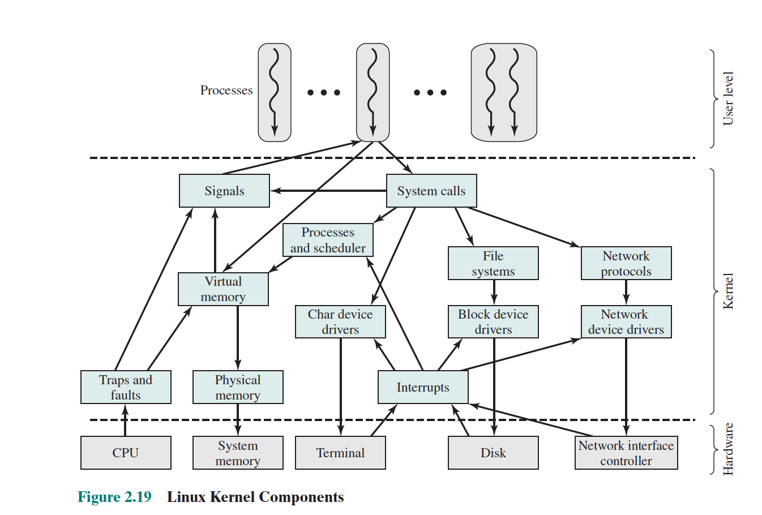
Linux Kernel Components

Slide 3
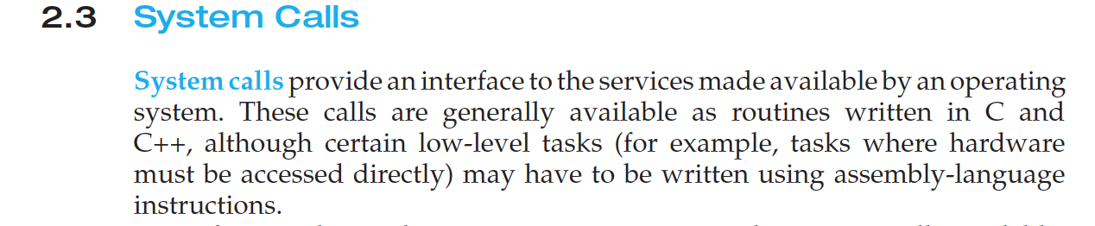
System Calls

Slide 4
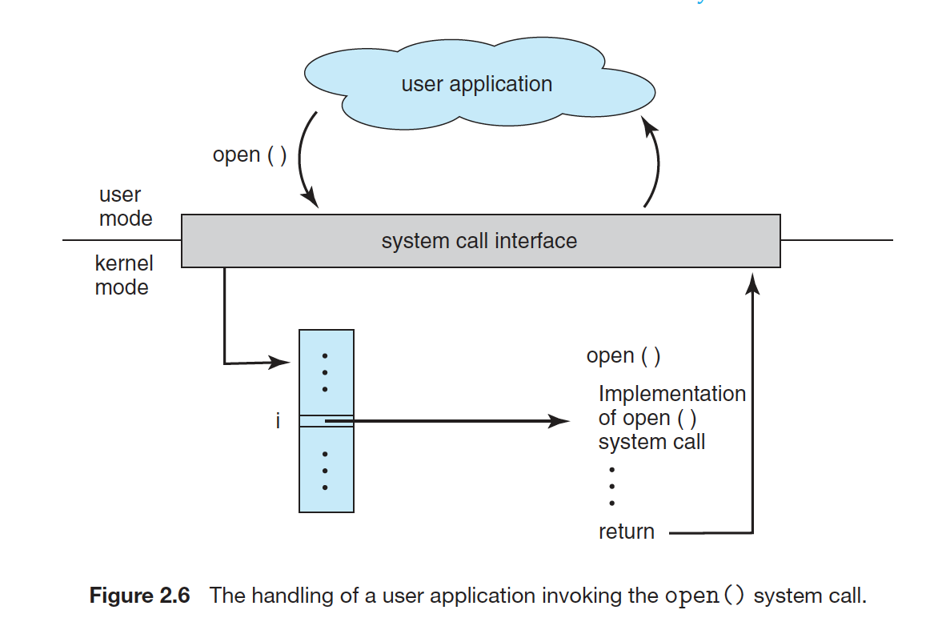
User Space (user mode) to Kernel Mode(kernel space)

Slide 5
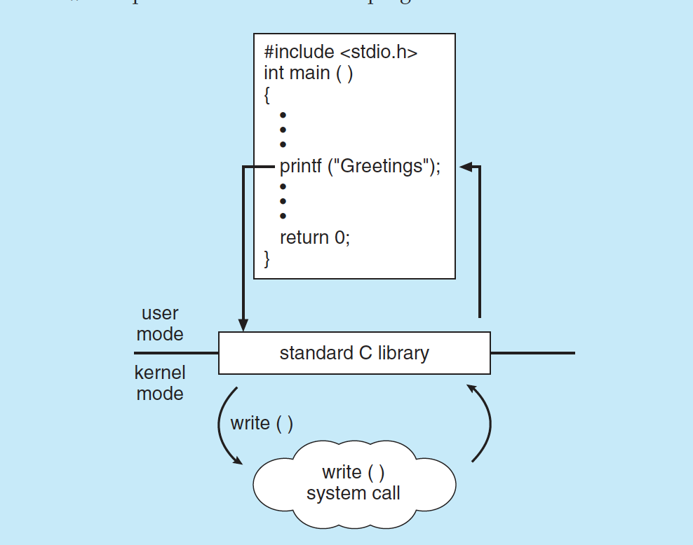
Implementation of printf() C function

Slide 6
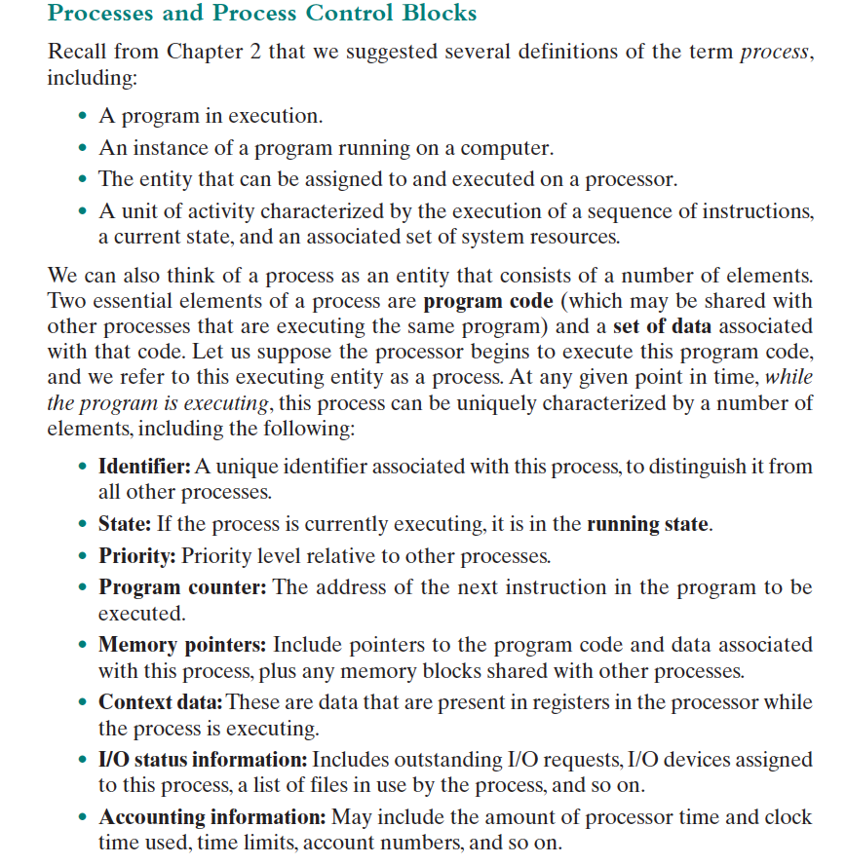
Process

Slide 7
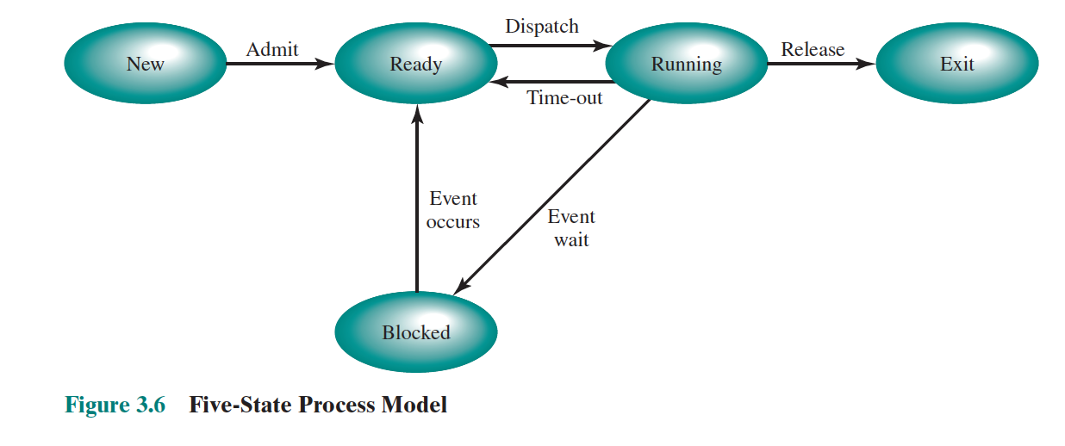
Process State Machine

Slide 8
Advantages of Threads
1. decomposing an application into multiple sequential threads that run in quasi-parallel, the programming model becomes simpler.
2. threads is that since they are lighter weight than processes, they are easier (i.e., faster) to create and destroy than processes.
3. A third reason for having threads is also a performance argument. Threads yield no performance gain when all of them are CPU bound, but when there is substantial computing and also substantial I/O, having threads allows these activities to overlap, thus speeding up the application.
4. Finally, threads are useful on systems with multiple CPUs, where real parallelism is possible.

Slide 9
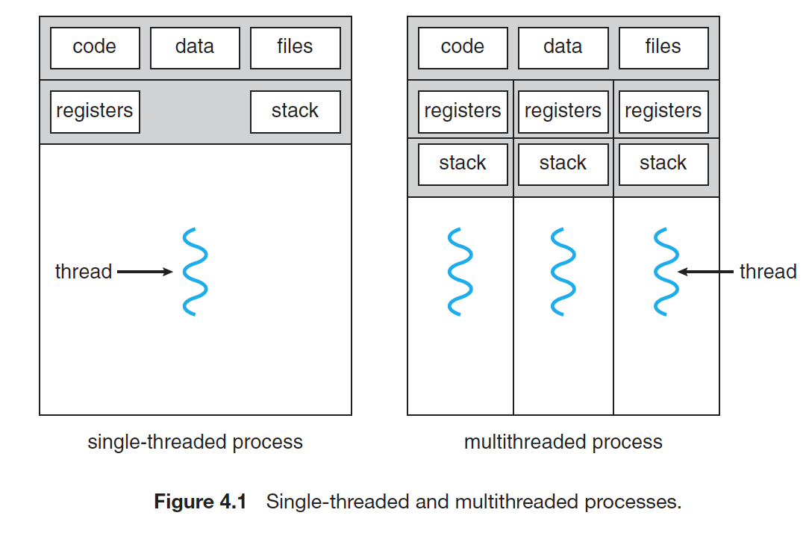
Threads have own registers and stack

Slide 10
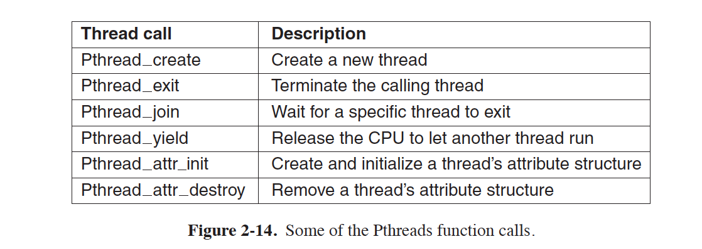

Slide 11
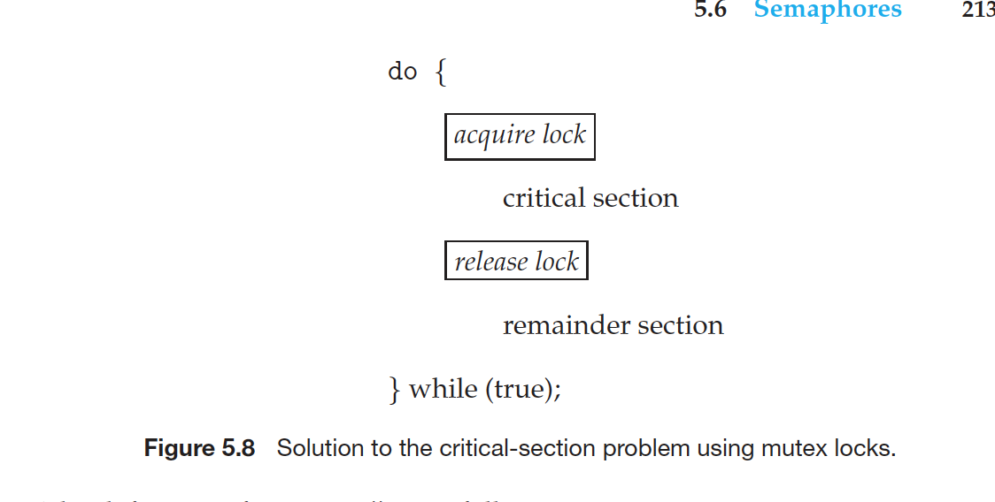
IPC, lock avoid critical data corruption

Slide 12
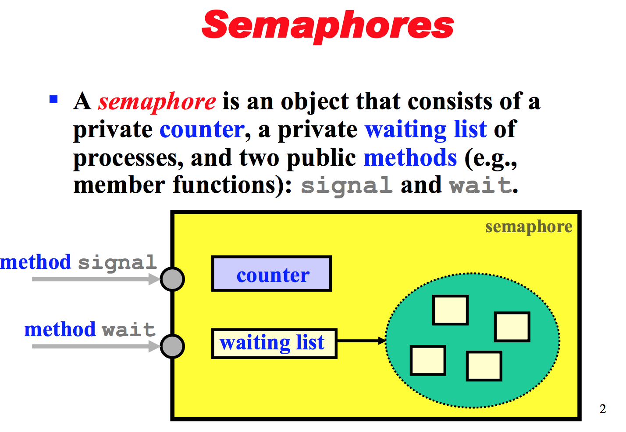
Semaphores

Slide 13
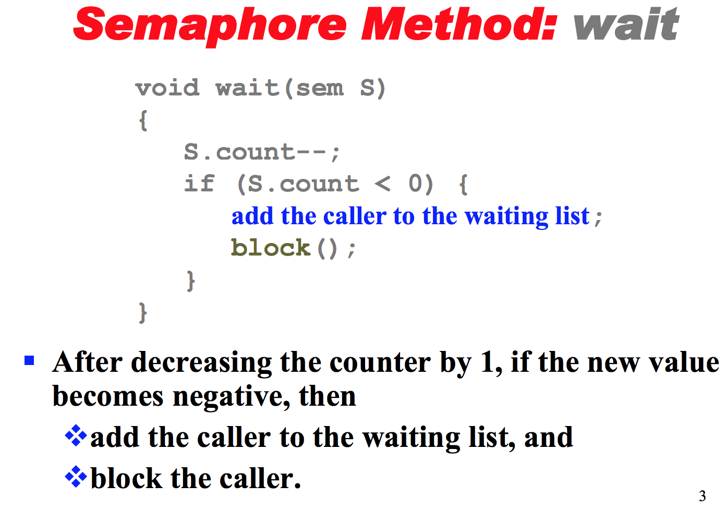
sem_wait()

Slide 14
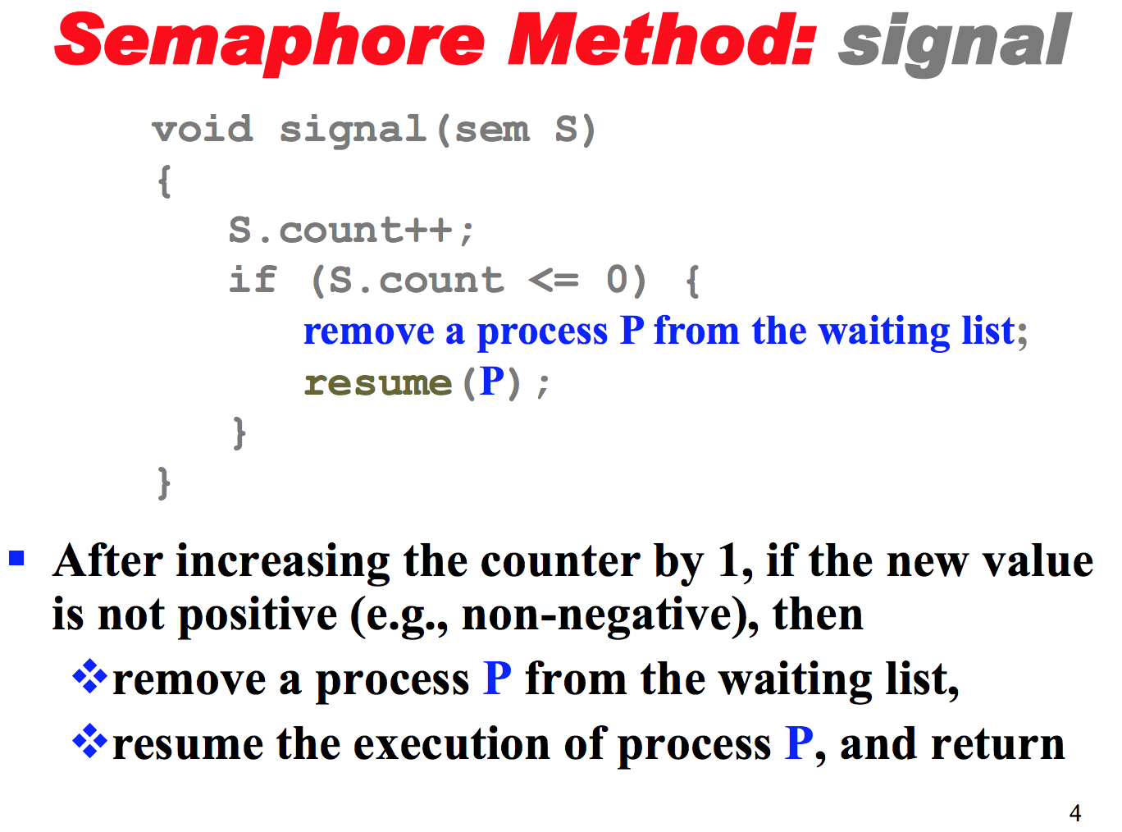
sem_post()

Slide 15
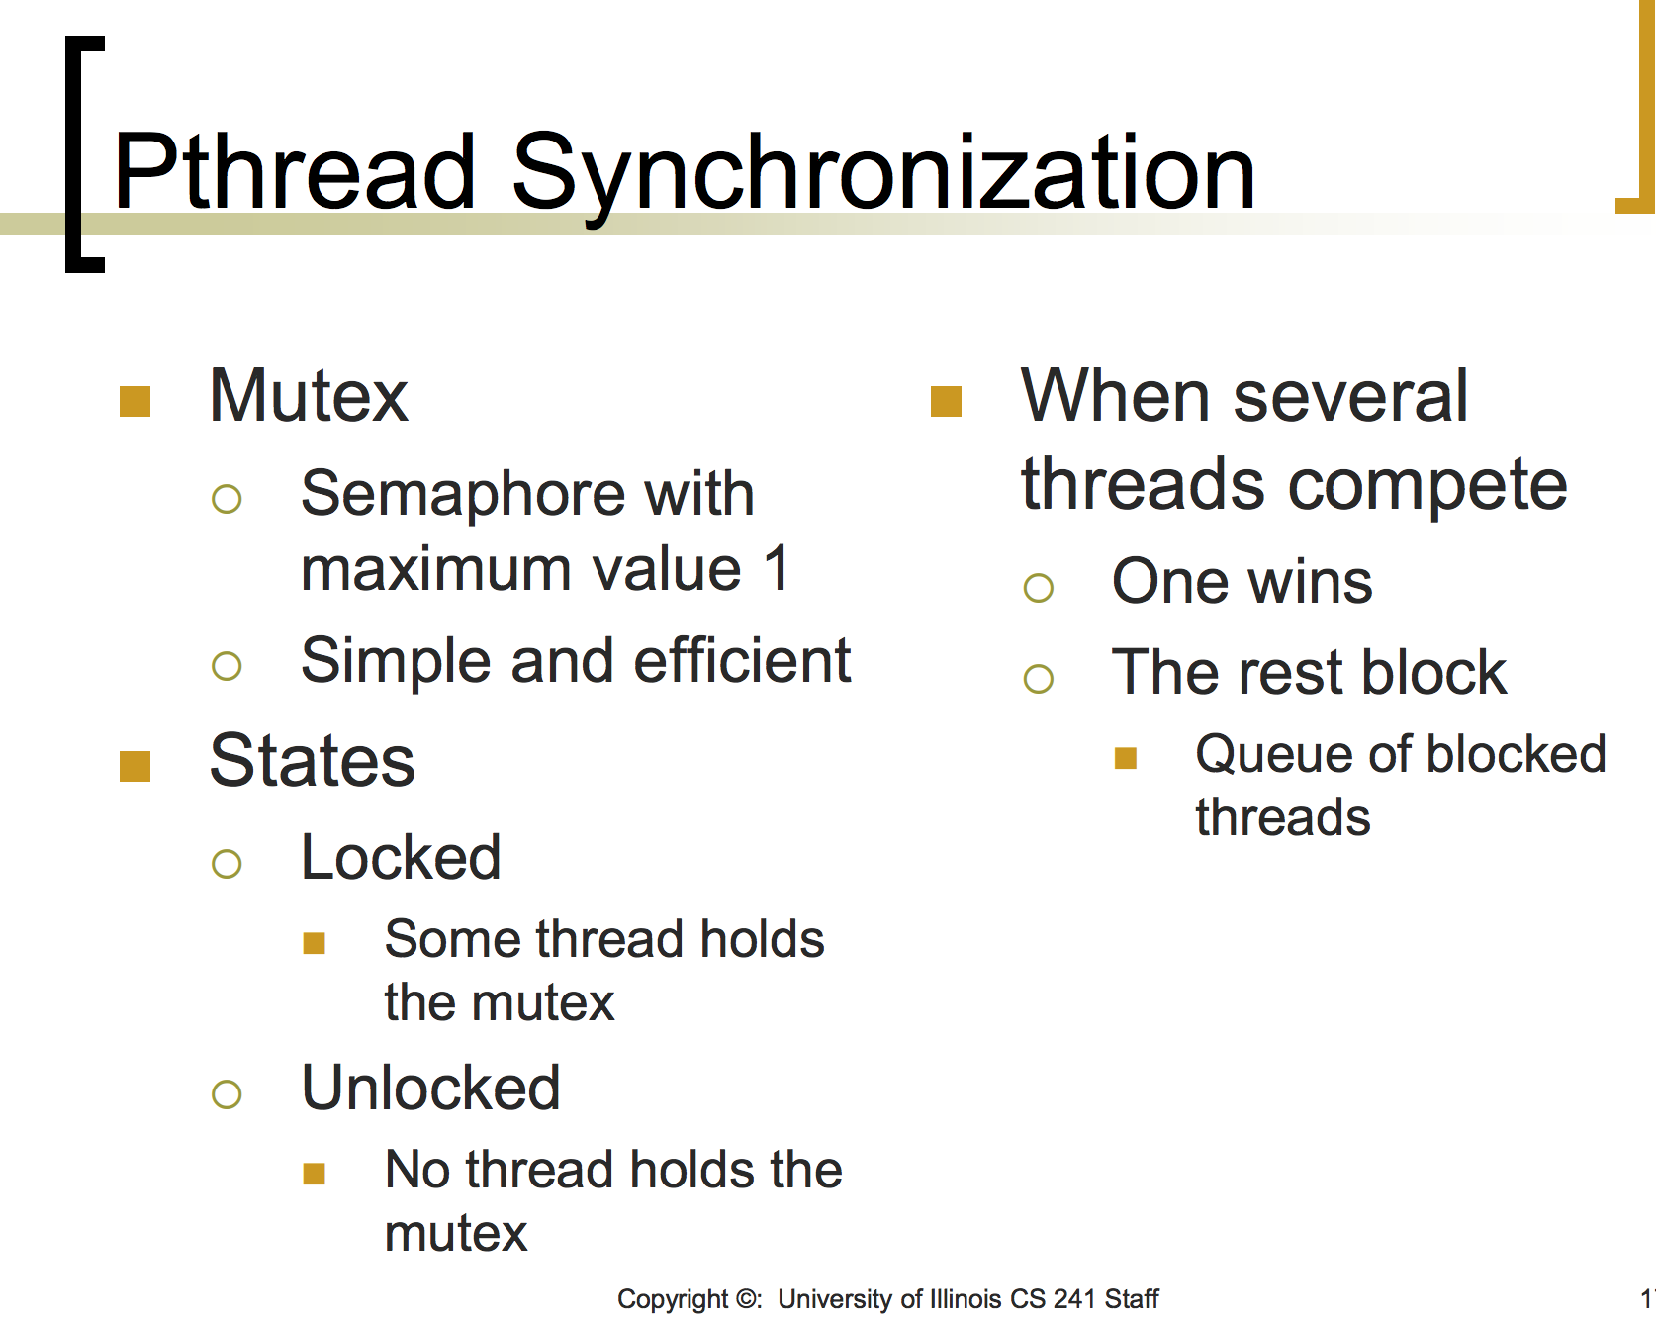

Slide 16
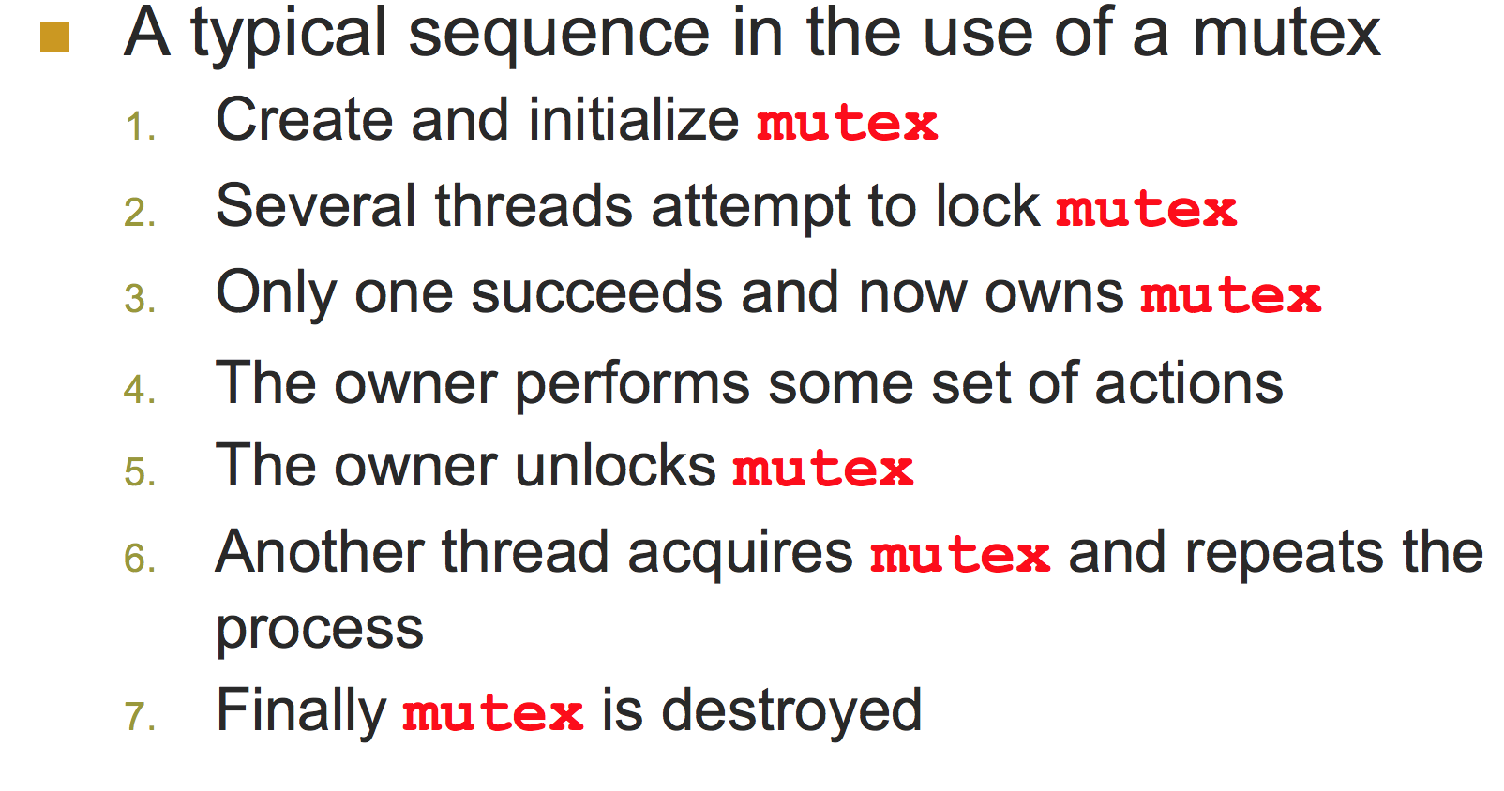
Mutex Sequence

Slide 17
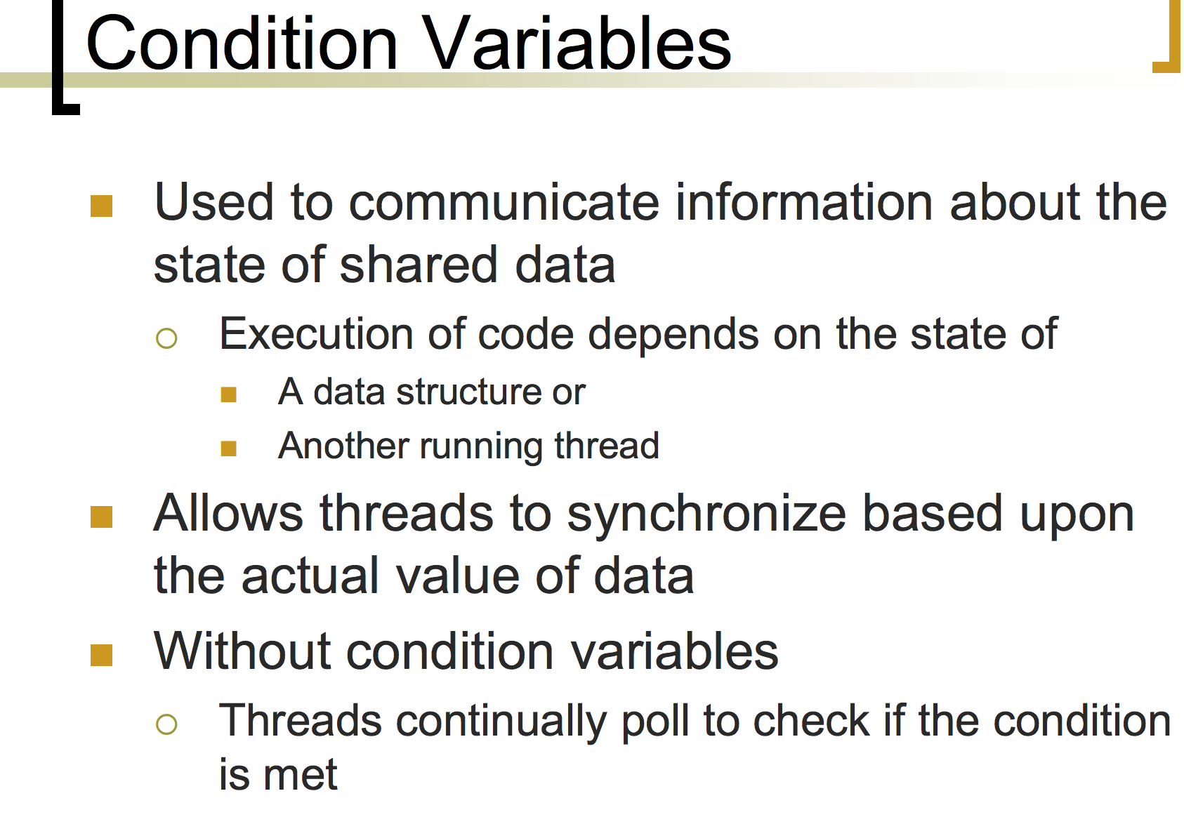
Condition Variables

Slide 18
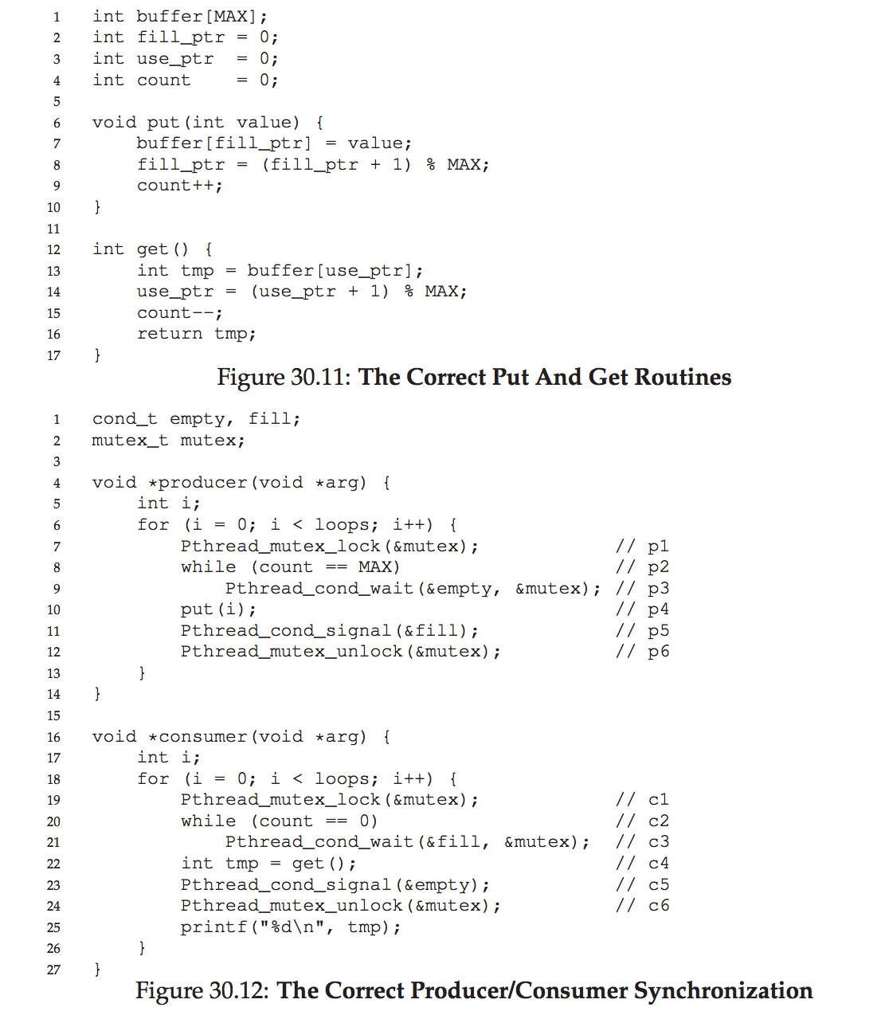
Condition Variable Program Example

Slide 19
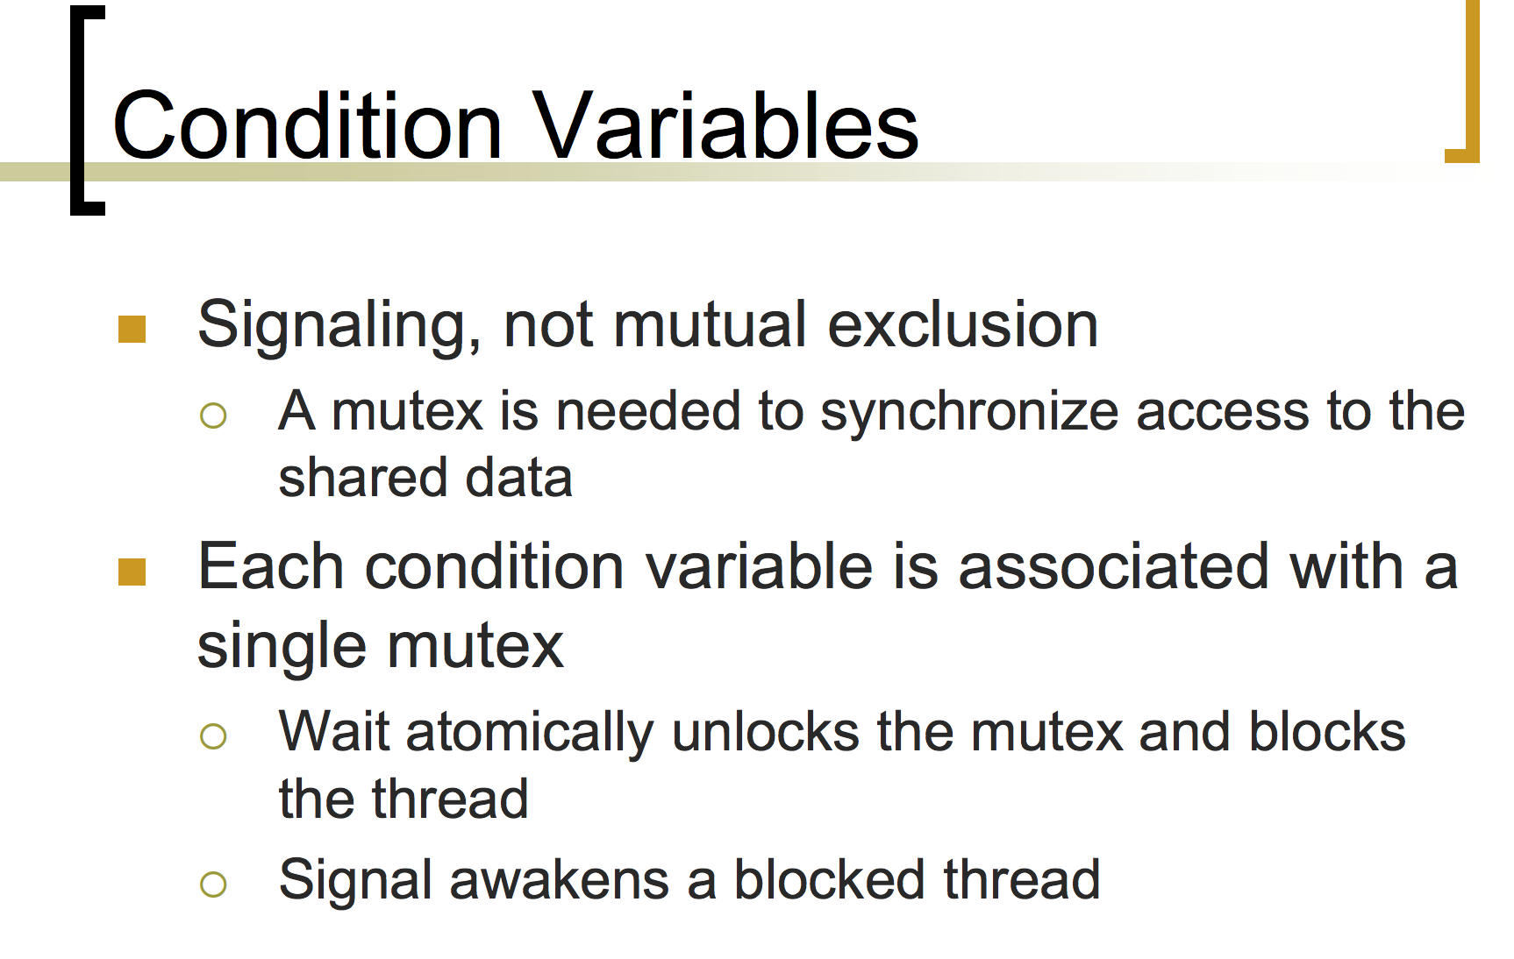

Slide 20
Inter Process Communication
Pipes
Message Queues
Memory Mapped Files
Sockets

Slide 21
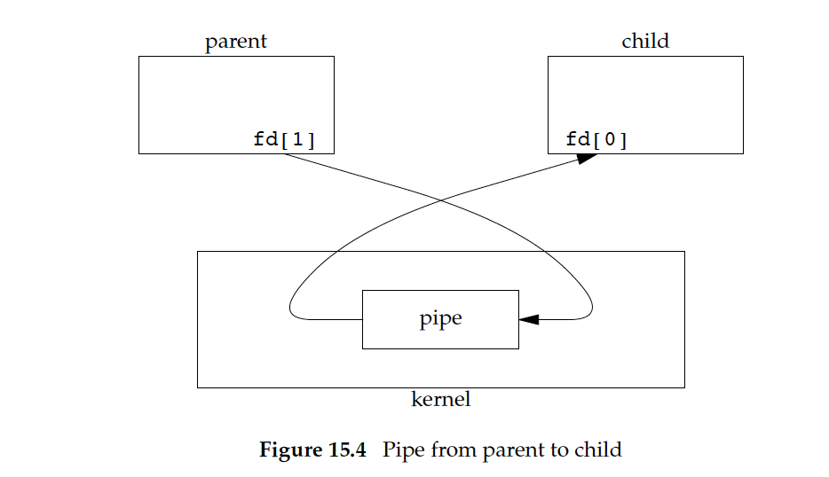
Pipes (check pipes program)

Slide 22
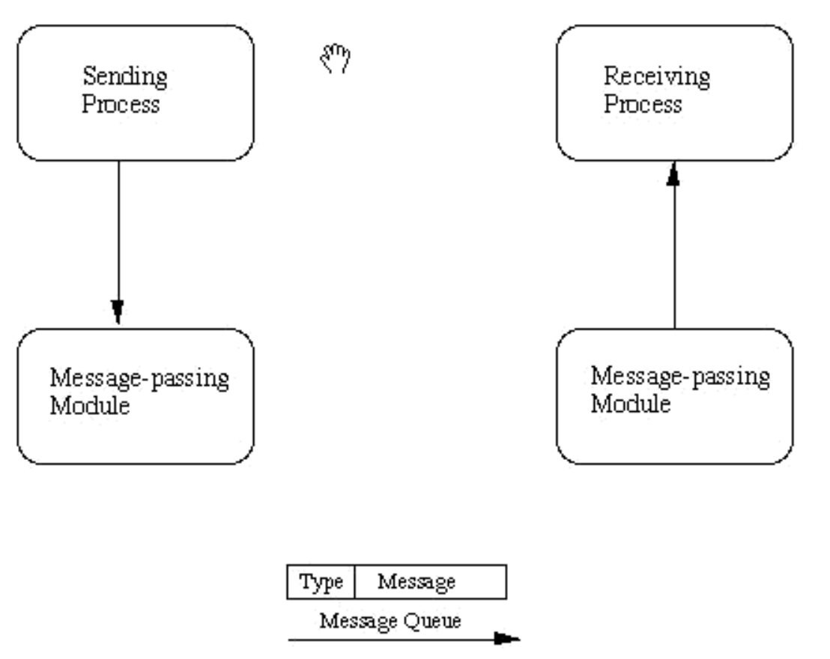
Message Queue (sample program)

Slide 23
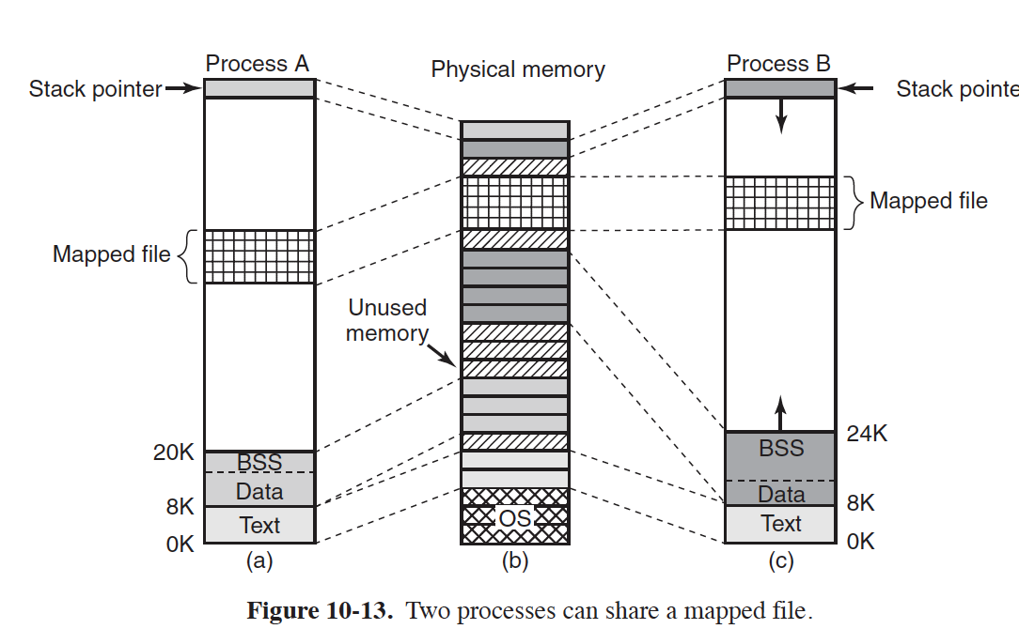
Memory mapped file between two processes

Slide 24
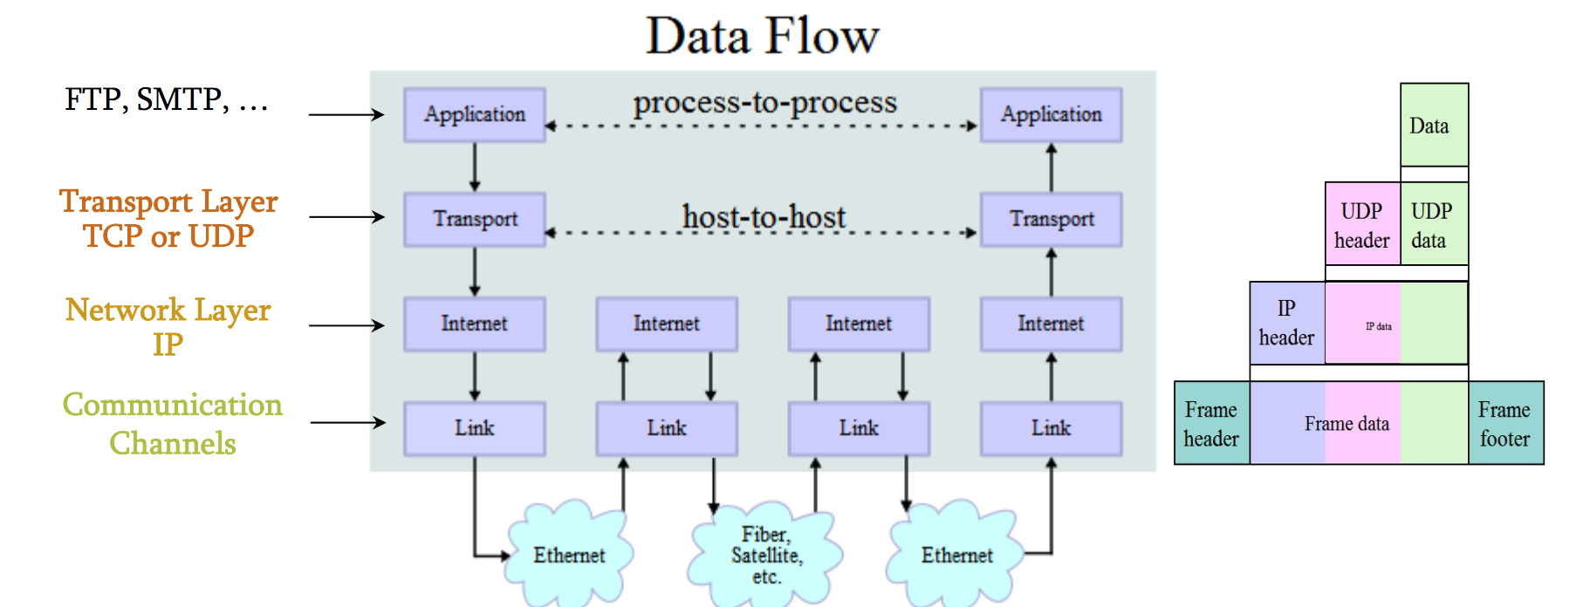
OSI Layer Model

Slide 25
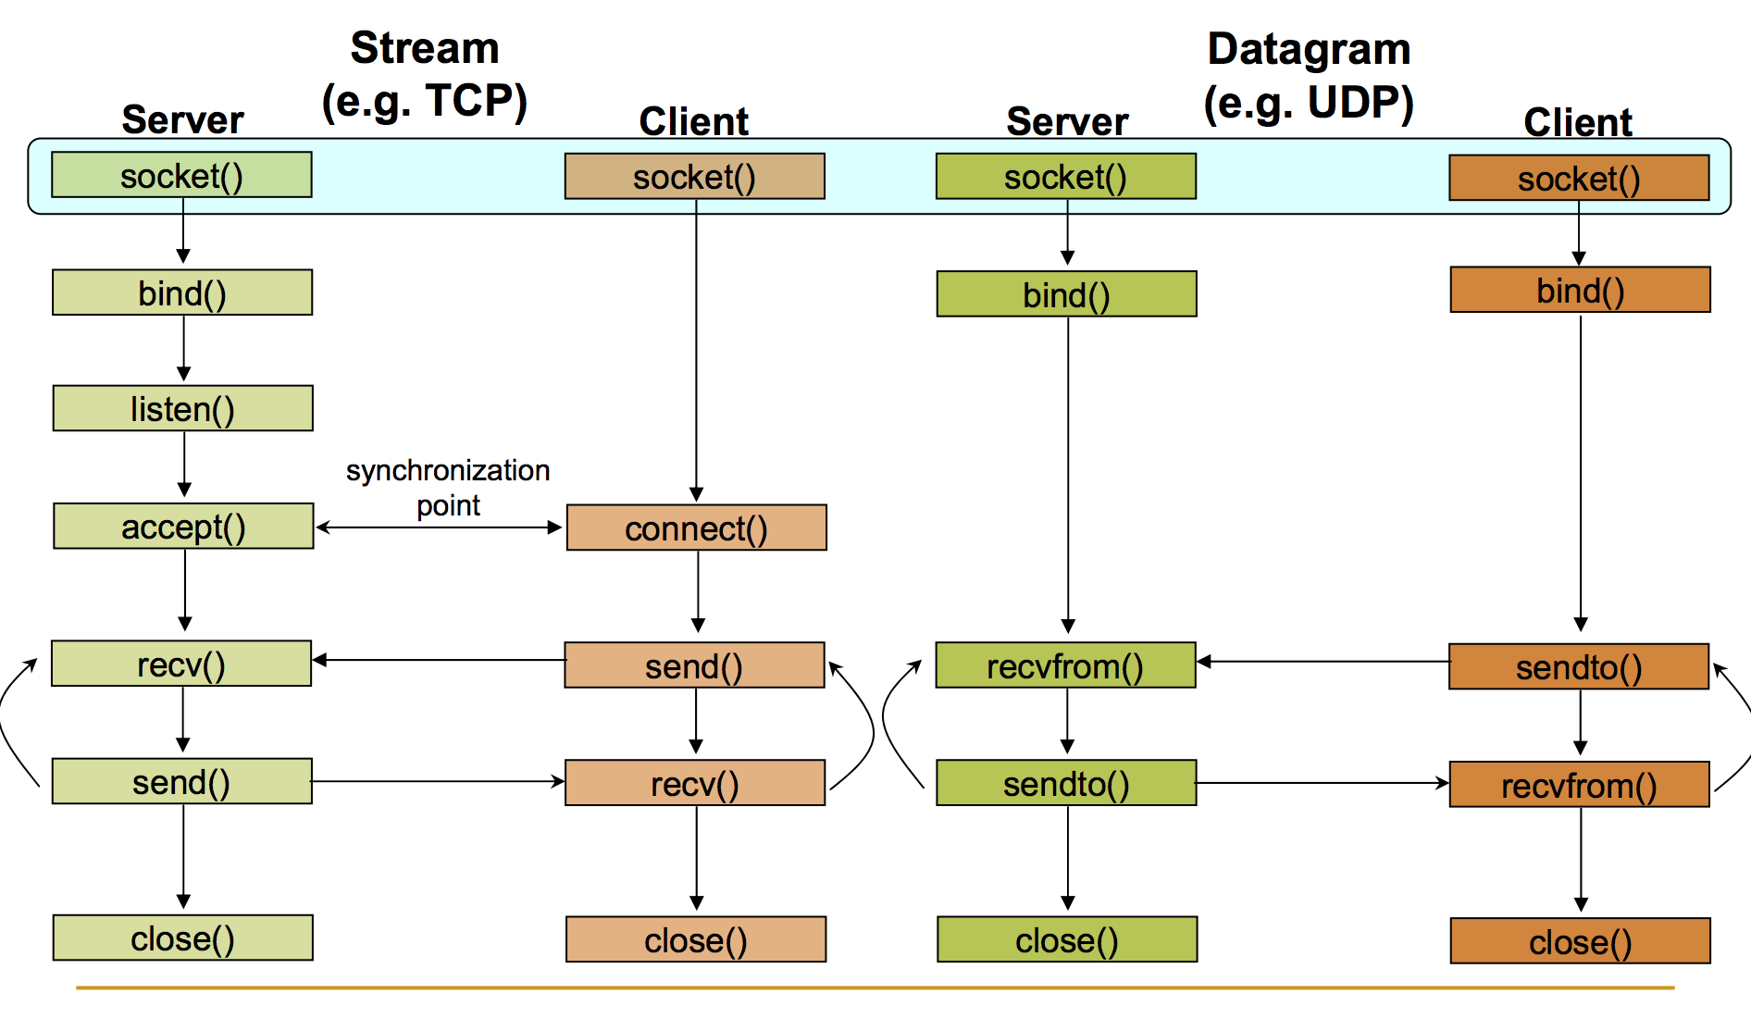
TCP/UDP client-server connections

Slide 26
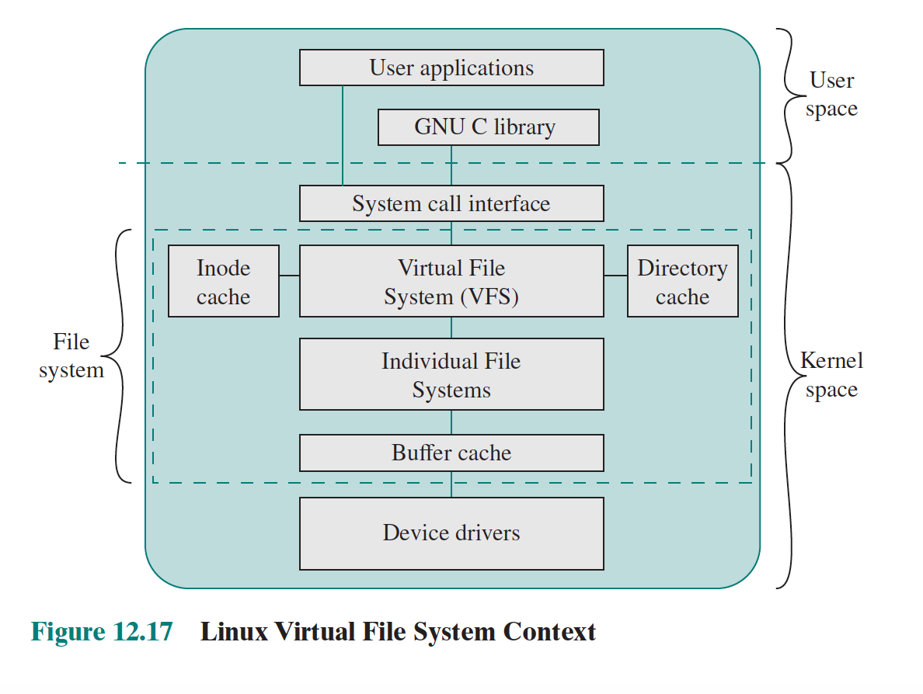
Virtual File System

Slide 27
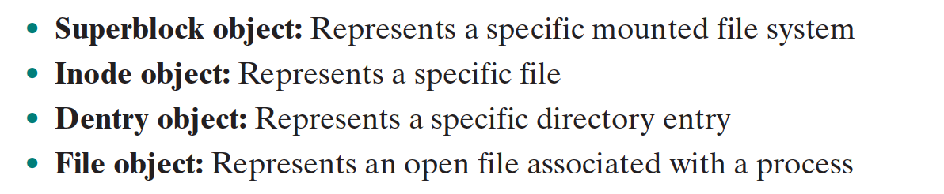
VFS Objects

Slide 28
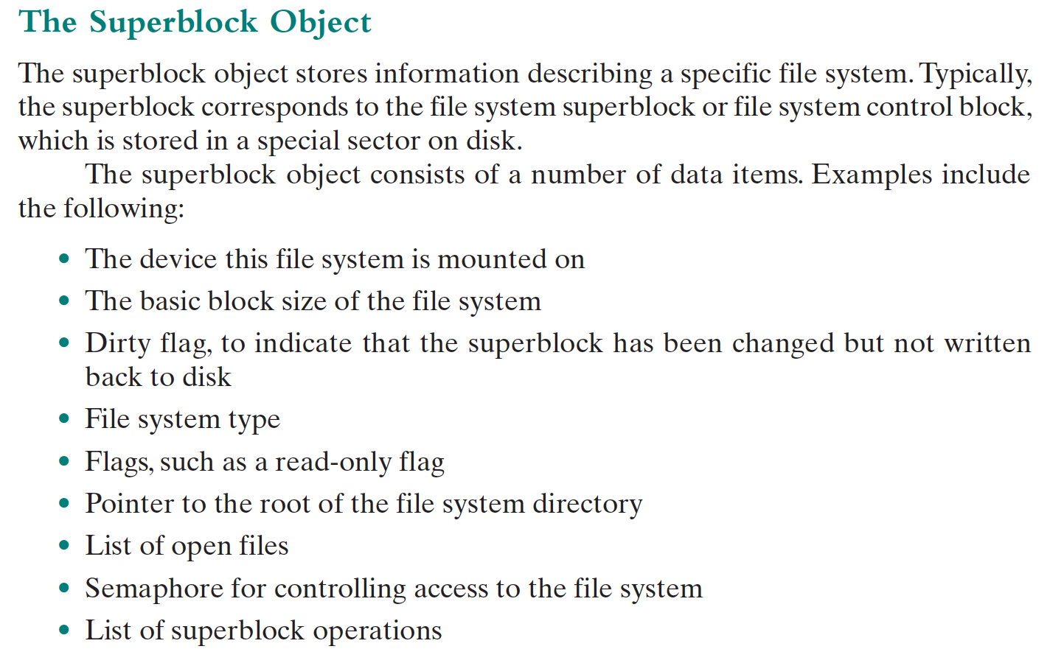
Superblock object

Slide 29
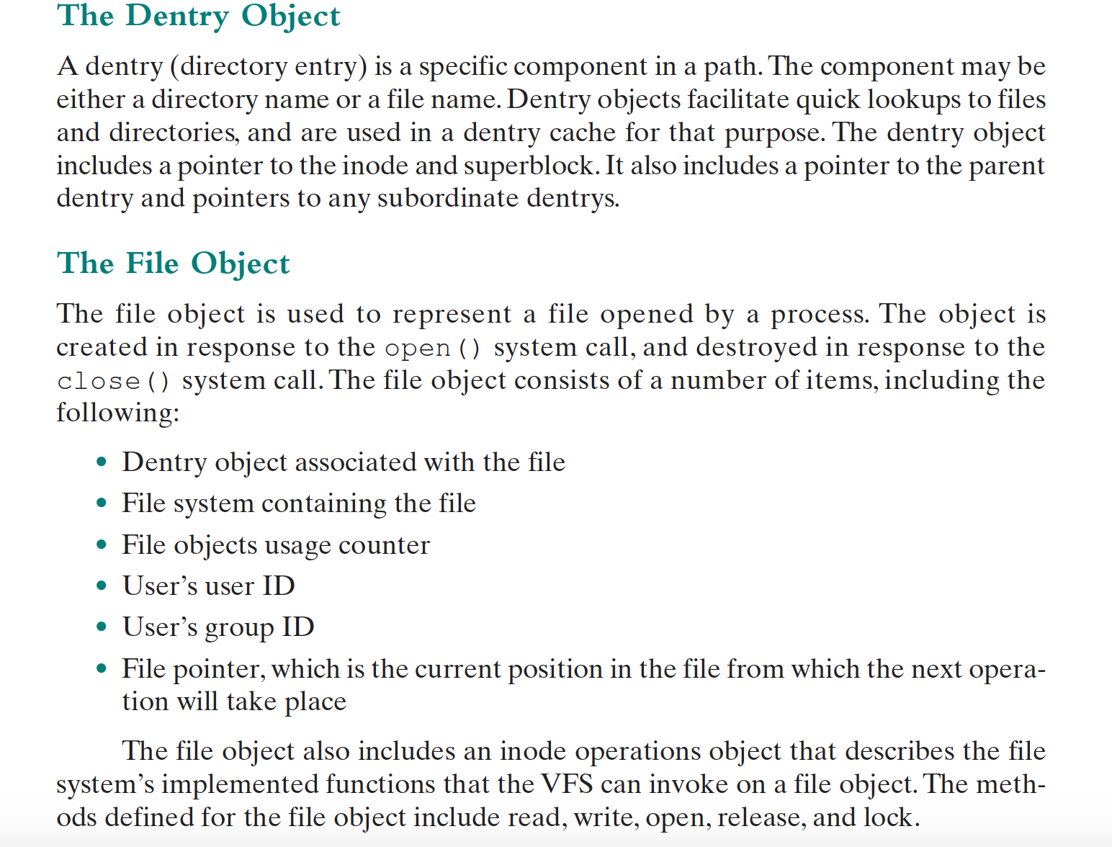
Dentry/File object

Slide 30
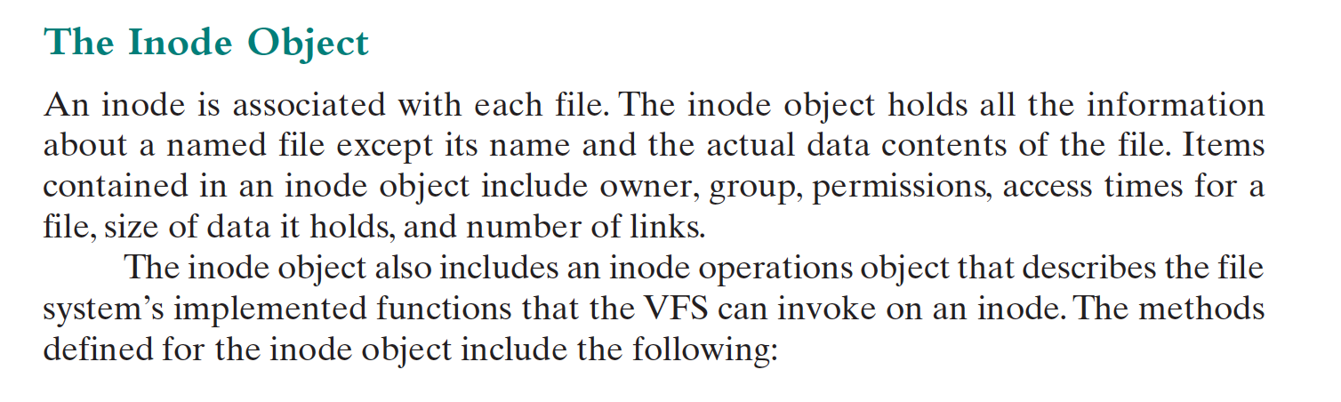
Inode Object

Slide 31
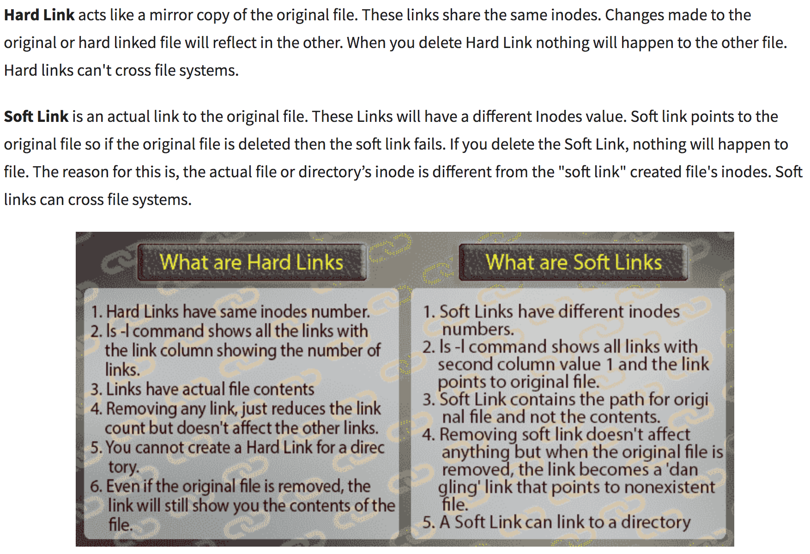
Soft Link and Hard Link

Slide 32
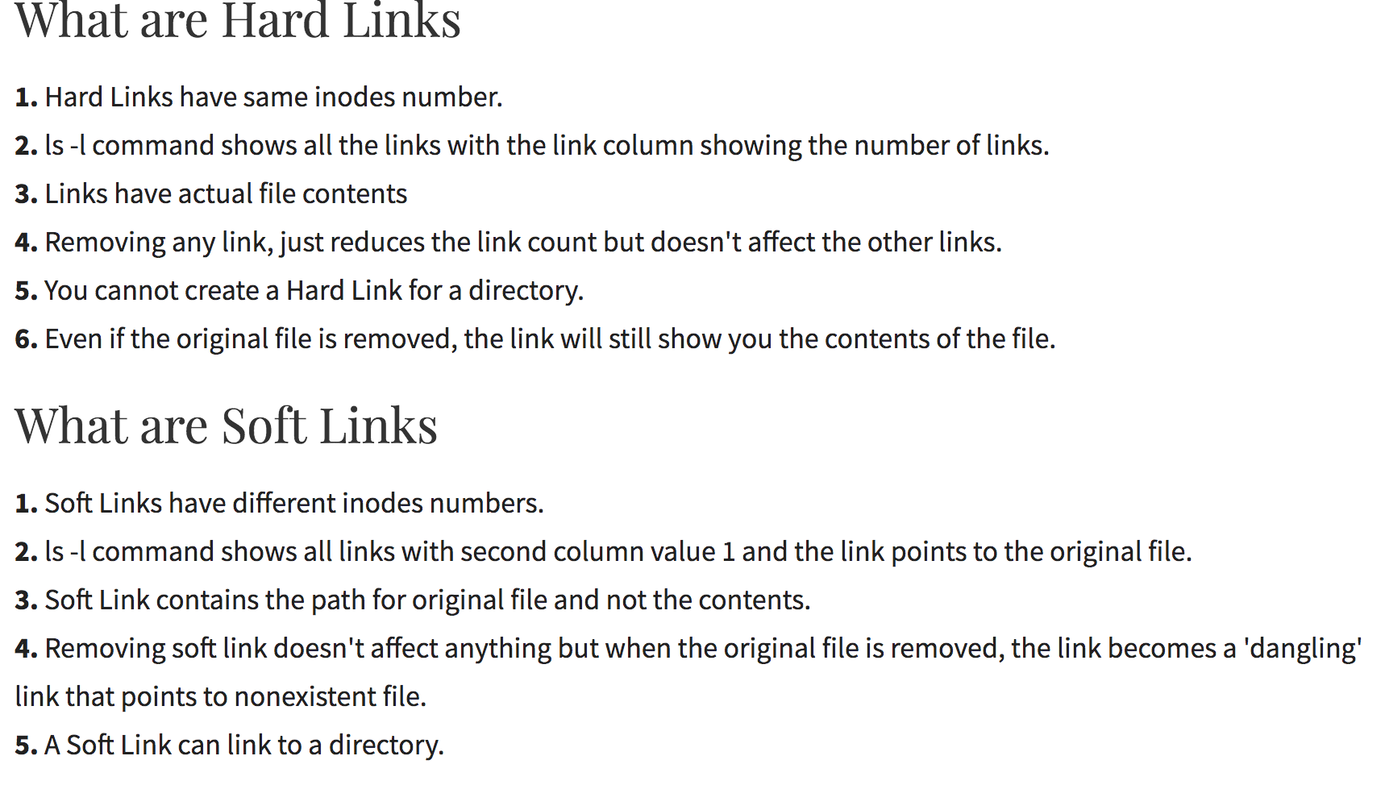
Soft Link / Hard Link

Slide 33
References
https://linoxide.com/linux-how-to/difference-soft-link-hard-link/
https://unix.stackexchange.com/questions/4402/what-is-a-superblock-inode-dentry-and-a-file

Slide 34
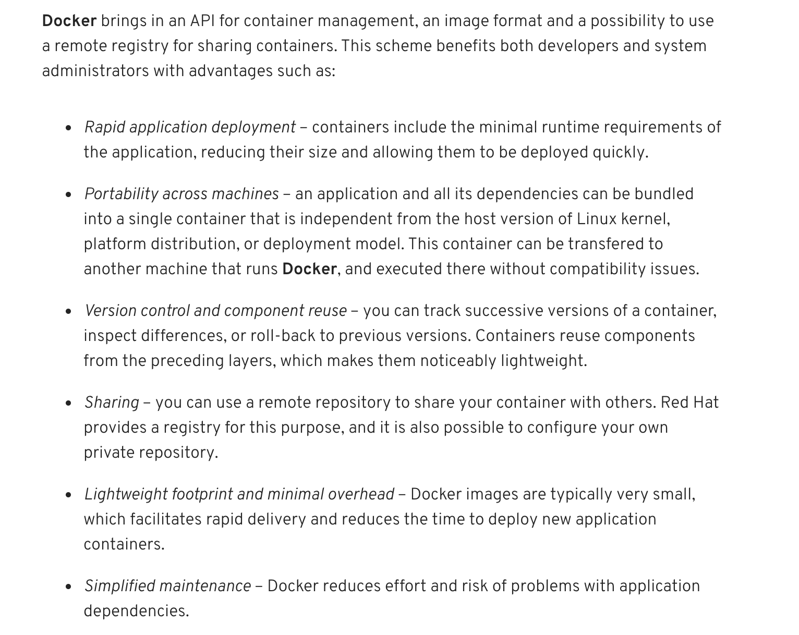
Docker Advantages

Slide 35
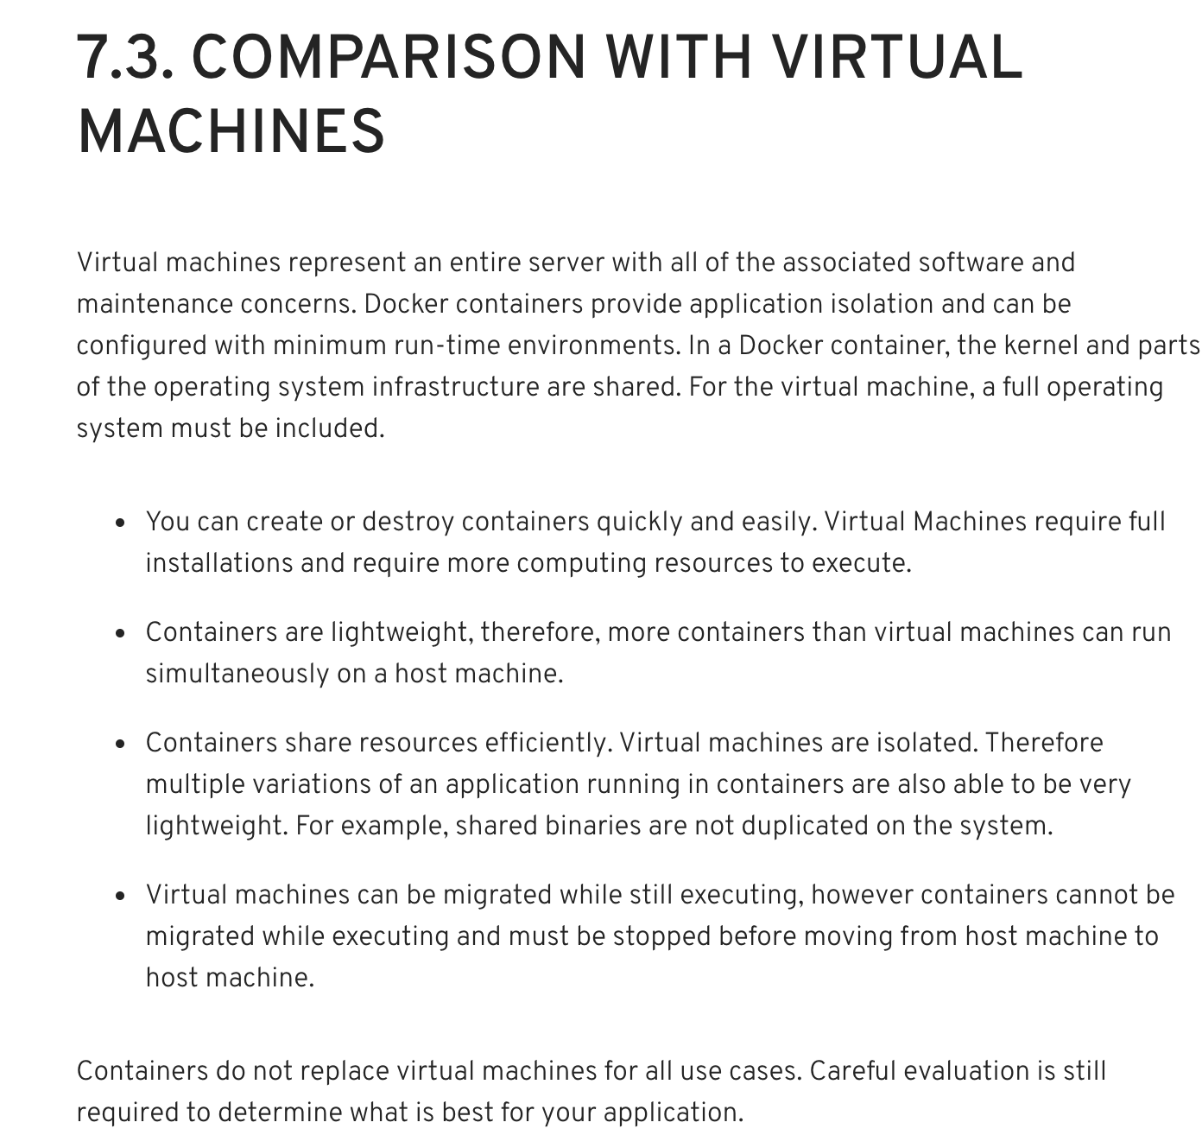
Container Vs Virtual Machines

Slide 36
https://access.redhat.com/documentation/en-us/red_hat_enterprise_linux/7/html/7.0_release_notes/sect-red_hat_enterprise_linux-7.0_release_notes-linux_containers_with_docker_format-advantages_of_using_docker
https://access.redhat.com/documentation/en-us/red_hat_enterprise_linux/7/html/7.0_release_notes/sect-red_hat_enterprise_linux-7.0_release_notes-linux_containers_with_docker_format-comparison_with_virtual_machines

Slide 37
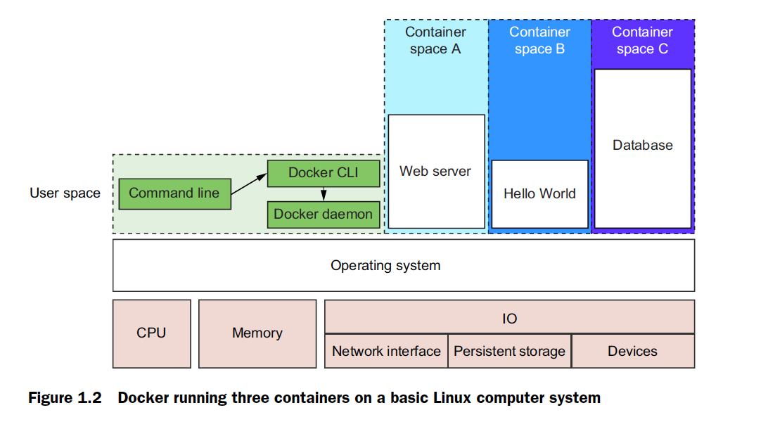
Docker container on Linux

Slide 38
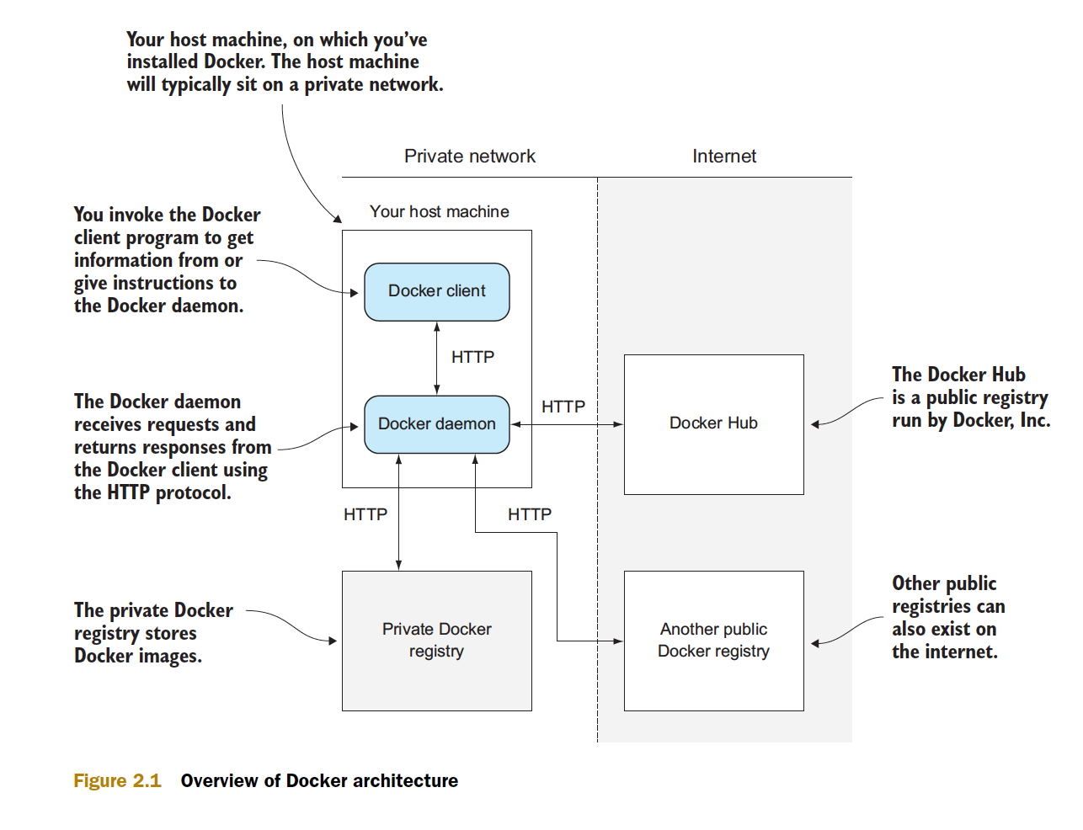
Docker Architecture

Slide 39
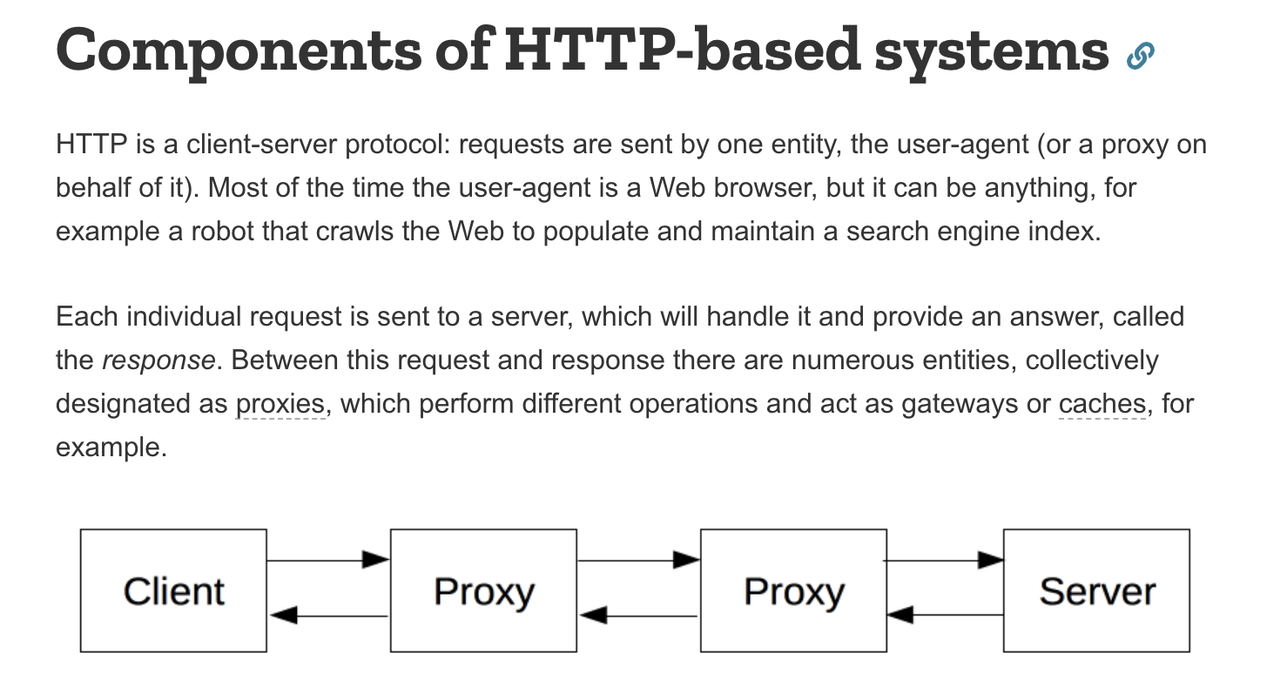
HTTP Protocol

Slide 40
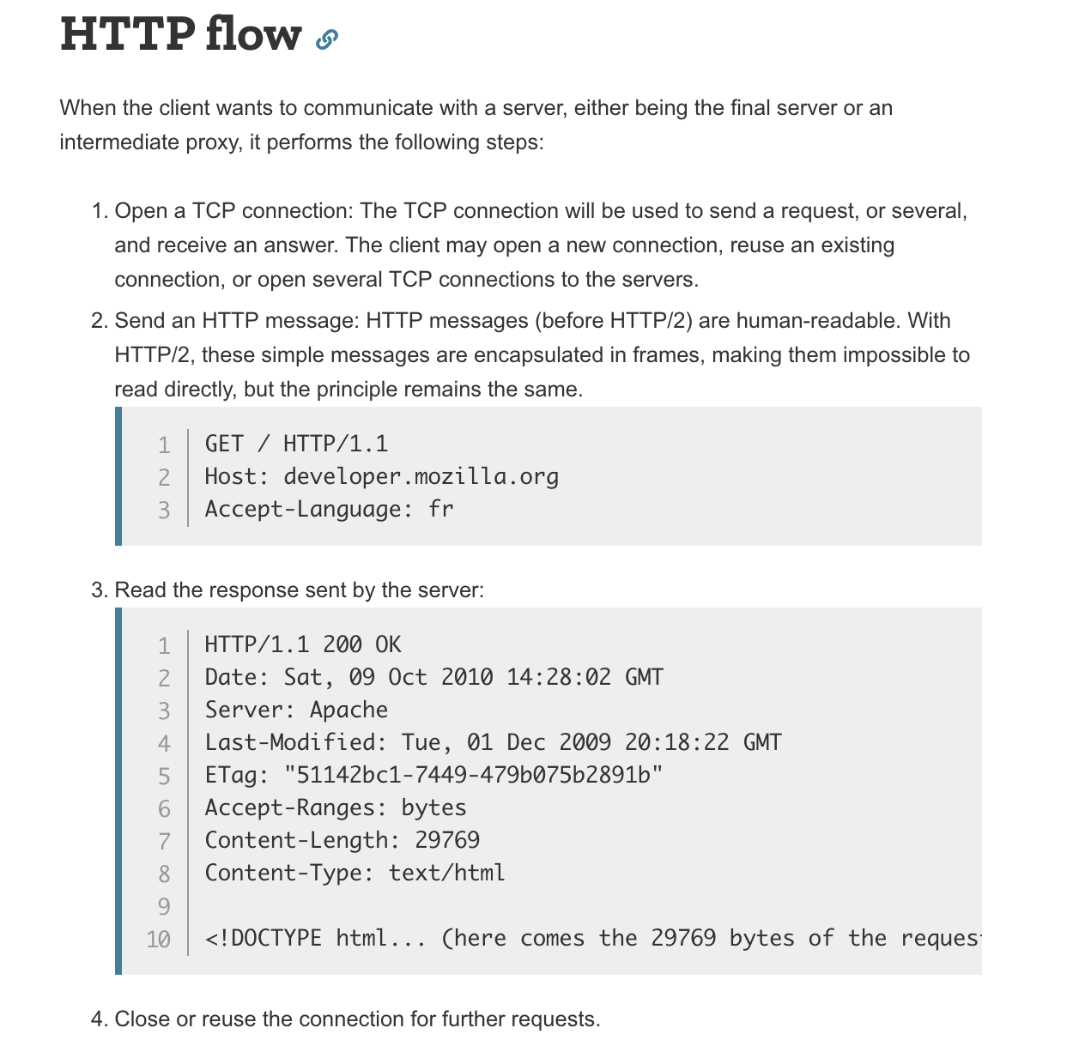
HTTP Messages

Slide 41
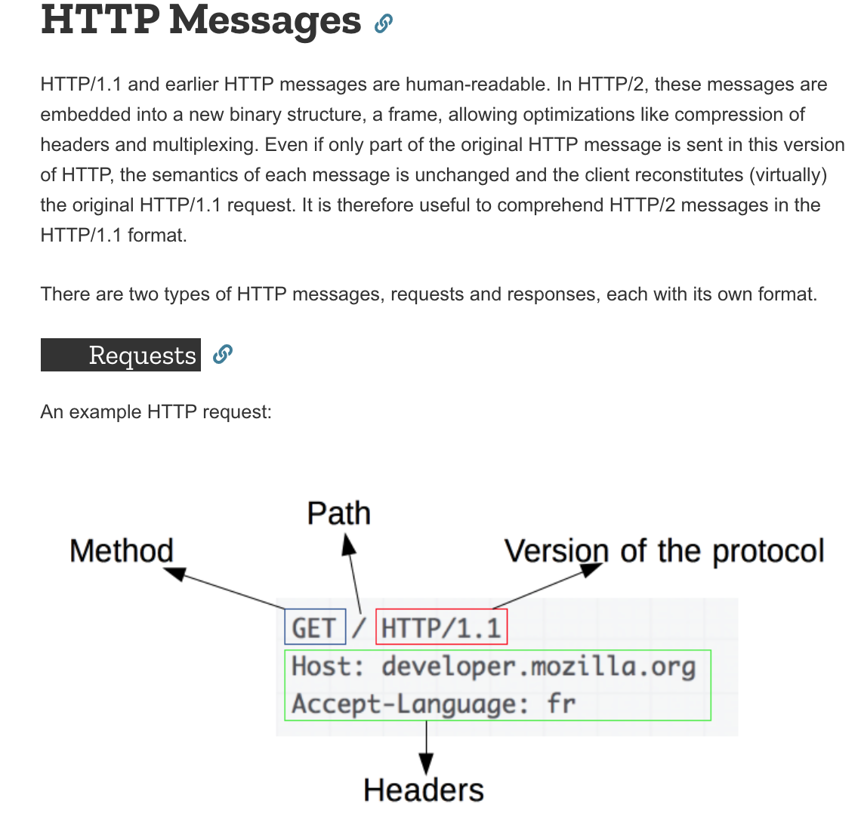
HTTP Messages

Slide 42
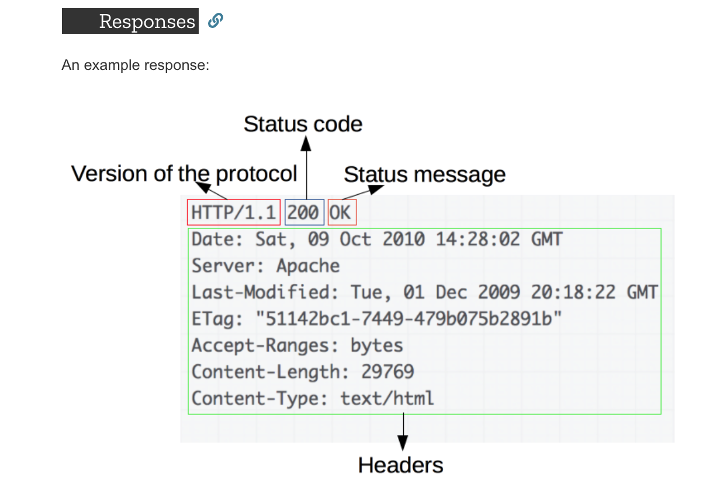
HTTP Messages

Slide 43
HTTP References
https://developer.mozilla.org/en-US/docs/Web/HTTP/Overview

